Slide 1
Regular Expression

Slide 2
Definition of Regular Expressions
A regular expression is a pattern that describes a set of strings.

Slide 3
Regular Expression Patterns
Characters and Numbers represent themselves. ‘abc’ matches abc.
. represents a single character or number. The pattern ‘b.e’ matches bee, bye, b6e, but not be b67e.
* represents zero or more characters.
+ represents one or more characters.
? zero or one character.

Slide 4
Regular Expression Patterns
I want to represent a US telephone number:
Will this work?
…-…-….
How about this?
***-***-***

Slide 5
Regular Expression Patterns
I want to represent a US telephone number:
Will this work?
…-…-….
123-456-7890 will match.
So will: abc-def-hijk
Not the best solution.

Slide 6
Regular Expression Patterns
{count} -defines an exact number of characters.
‘a{3}’defines exactly three character a’s or ‘aaa’.
‘.{4}’ matches any four characters.
We could define the phone number as:
.{3}-.{3}-.{4}

Slide 7
Regular Expression Patterns
{min, max} –defines a minimum and a maximum number of characters.
‘.{2,8}’ matches any 2 or more characters, up to 8 characters.
{min,} –defines a minimum or more characters. There is no maximum.

Slide 8
Regular Expression Patterns
What does the pattern sto{1,}p match?
stop
stp
stoip
stoop
stooop
stoooooooooop

Slide 9
Regular Expression Patterns
[ ] –defines a subset of an expression. Any one character will match the pattern.
[1234567890] will match any number, not a letter.
The phone number pattern becomes:
[1234567890]{3}-[1234567890]{3}-[1234567890]{4}

Slide 10
Regular Expression Patterns
You can also define a range in the brackets.
[0-9]{3}-[0-9]{3}-[0-9]{4}
Define uppercase letters: [A-Z]
Upper or lower case: [a-zA-Z]

Slide 11
Regular Expression Patterns
What does the pattern st[aeiou][A-Za-z] match?
stop stay string
Step steP steal
How about abc[3-9]?
acb1 abc3 abcd
abc8 abc9 abc2

Slide 12
Regular Expression Patterns
The caret (^) in a bracket matches any characters except the characters following the caret.
st[^o]p will match:
step stip strp stop

Slide 13
Regular Expression Patterns
^ -the pattern will match only the beginning of the string.
$ -the pattern will match only the end of the string. Does not include CR or line feeds.
^St[a-z] matches text that starts with ‘St’, followed by one or more lower case letters.

Slide 14
Regular Expression Patterns
stop$ -only matches stop if it is at the last word of the line.
| or vertical bar defines a Boolean OR.
[1-9]|[a-z] matches a number or lowercase letter.

Slide 15
Regular Expression Patterns
Escape Character (\)
Sometimes you want to match a character that has a defined meaning.
Match a number with two decimal points.
[0-9]+.[0-9]{2}

Slide 16
Regular Expression Patterns
Use the escape character to tell the parser the period is the character period.
[0-9]+\.[0-9]{2}

Slide 17
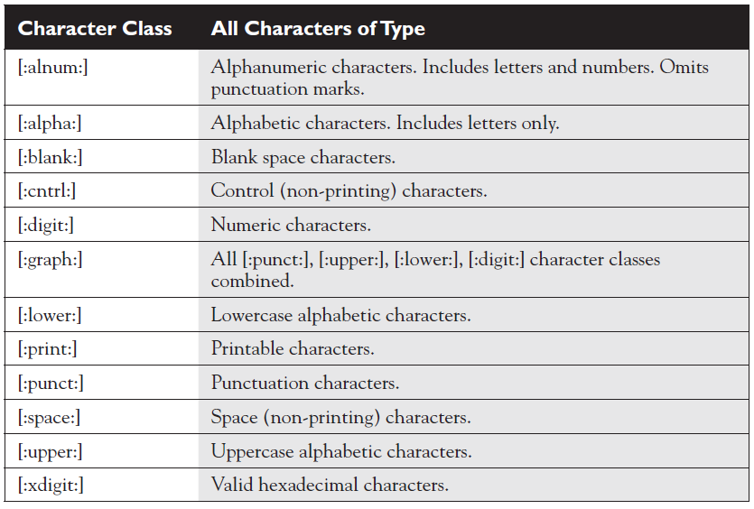

Slide 18
Regular Expression Patterns
Phone Number with Class Operators:
[:digit:]{3}-[:digit:]{3}-[:digit:]{4}

Slide 19
Being Greedy
Regular Expression parsers are greedy.
Returns the largest set of characters that matches the pattern.
My pattern: .*4
Zero or more characters followed by a 4.
My string is: 123423434
The first match is the entire string.

Slide 20
Being Greedy
My pattern: ([:digit:]{3}-){3}
3 digits followed by a dash, 3 times
My string is: 123-423-434-987-
The first match is?

Slide 21
Being Greedy
My pattern: ([:digit:]{3}-){3}
3 digits followed by a dash, 3 times
My string is: 123-423-434-987-
The first match is ‘123-423-434-’.
Matching starts from the first character.

Slide 22
Expression Grouping
Also called: Tagging or Referencing
Allows a part of the pattern to be grouped.
There can only be 9 groups.
Groups are referenced using \1-9

Slide 23
Expression Grouping
My pattern: ([a-z]+) ([a-z]+)
Matches two lower case words.
If the matching string is ‘fast stop’then
\1 references ‘fast and \2 references ‘stop’
\1 \2 results in ‘fast stop’
\2 \1 results in ‘stop fast’

Slide 24
What is this RegEx?
(1[012]|[1-9]):[0-5][0-9]
Time format. 10:30, 7:45
How about this one? [:digit:]{5}(-[:digit:]{4})?
US Zip Code
How about this one? #(9*&)@$%
A cartoon cuss word, not a RegEx.

Slide 25
What is this RegEx?
(1[012]|[1-9]):[0-5][0-9]
Time format. 10:30, 7:45
How about this one? [:digit:]{5}(-[:digit:]{4})?
US Zip Code
How about this one? #(9*&)@$%
A cartoon cuss word, not a RegEx.

Slide 26
Oracle REGEXP_XXXXXX Functions
They operate on the database character datatypes to include VARCHAR2, CHAR, CLOB, NVARCHAR2, NCHAR, and NCLOB.

Slide 27
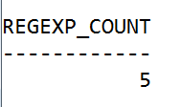
Oracle REGEXP_XXXXXX Functions
REGEXP_COUNT
(source_char, pattern [, position [, match_param]])

Slide 28
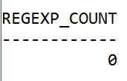
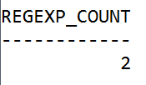
Oracle REGEXP_XXXXXX Functions

Slide 29
Oracle REGEXP_XXXXXX Functions
REGEXP_INSTR (source_char, pattern [, position
[, occurrence [, return_opt
[, match_param [, subexpr]
]
]
]
]
)

Slide 30
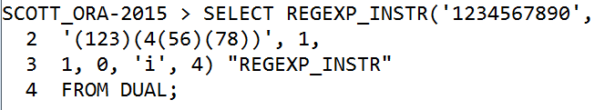
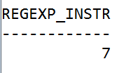
Oracle REGEXP_XXXXXX Functions

Slide 31
Oracle REGEXP_XXXXXX Functions
REGEXP_REPLACE(source_char, pattern [, replace_string
[, position [, occurrence
[, match_param ]
]
]
]
)

Slide 32

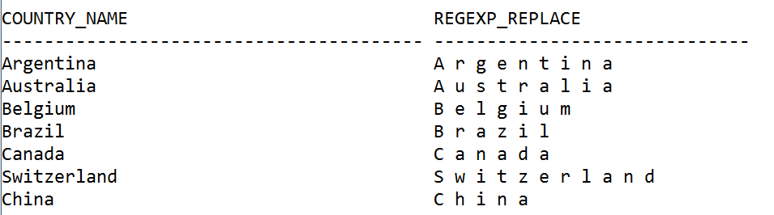
Oracle REGEXP_XXXXXX Functions

Slide 33
Oracle REGEXP_XXXXXX Functions
REGEXP_SUBSTR(source_char, pattern [, position
[, occurrence [, match_param
[, subexpr ]
]
]
]
)

Slide 34
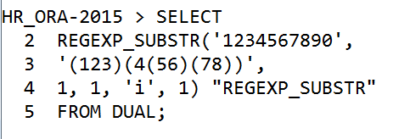

Oracle REGEXP_XXXXXX Functions

Slide 35
Oracle REGEXP_XXXXXX Functions
REGEXP_LIKE(source_char,
pattern
[, position ]
)

Slide 36
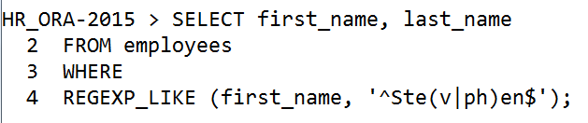
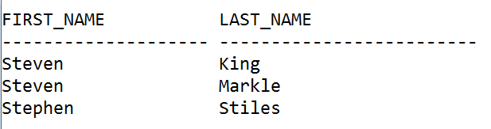
Oracle REGEXP_XXXXXX Functions

